Slide 1

PRESENTATION
CUSTOMER CHURN
PREDICTION ANALYSIS
TELECOM CUSTOMER RETENTION
INSIGHTS AND STRATEGY
DATA SOURCE FOCUS
TELECOM CUSTOMER DATASET (N=7,043) PREDICTIVE MODELING RETENTION STRATEGY
OBJECTIVE:
Predict which customers are likely to churn based on behavior, service usage, and demographics.
Deliverables:
  Churn prediction model
  Key churn drivers
  Retention strategy recommendations

Slide 2
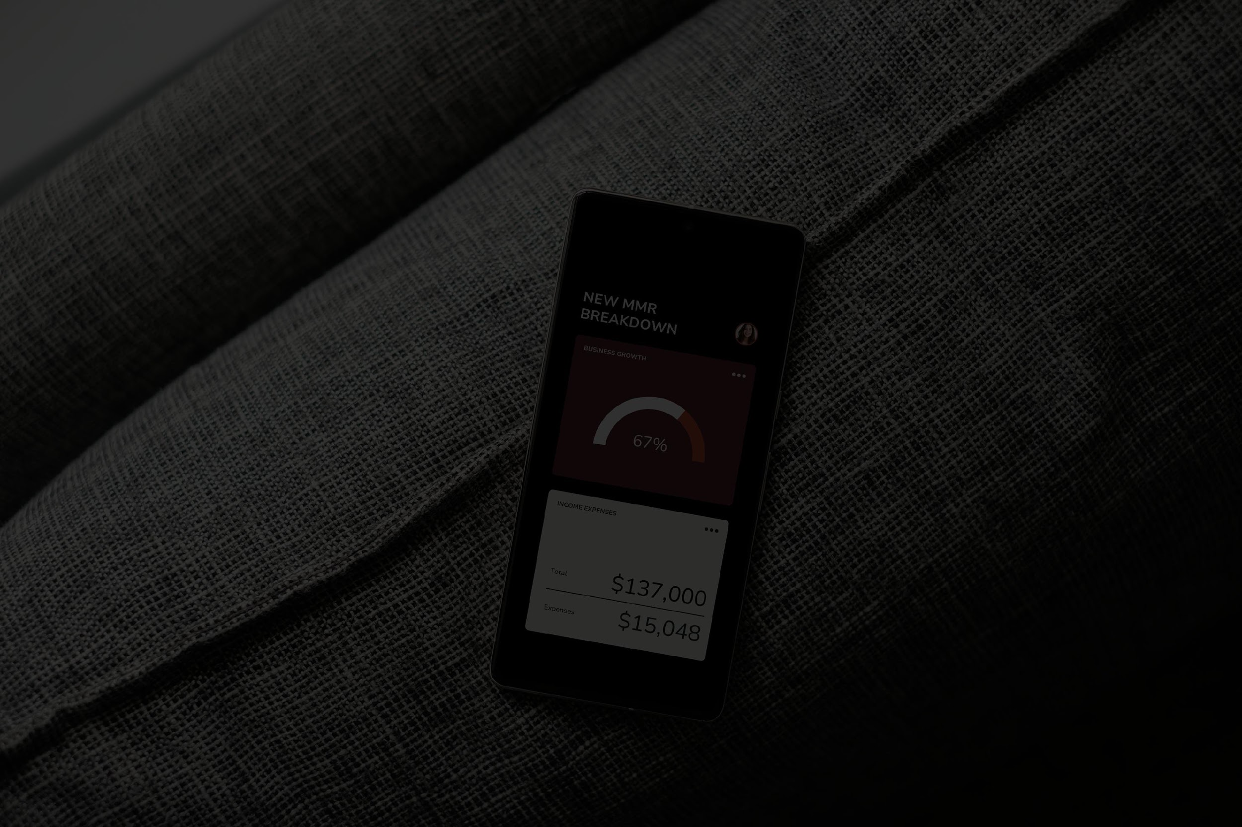
DATA SET OVERVIEW
COMPREHENSIVE ANALYSIS OF CUSTOMER BEHAVIOR, AND SERVICE USAGE
7,043
22
99.8%
CHURN STATUS
Binary Classification Values: Yes/ NO
KEY FEATURES
  Customer Demographics (gender, senior citizen, dependents)
  Service Usage (phone, internet, security, backup, streaming)
  Billing Information (MonthlyCharges, TotalCharges)
  Subscription Details (contract type, payment method)
TOTAL CUSTOMERS
ATTRIBUTES
DATA COMPLETENESS
Unique customer records
Demographics Services Billing
Only 11 rows missing (Total Charges)

Slide 3
BEFORE MOVING FORWARD A QUICK ANALYSIS OF THE DATA SET
ANALYSIS USING THE GIVEN POINTS:
  Contract Type Analysis
  Payment Method Analysis
  Internet Type Service Impact
  Demographics
&
Billing Insights

Slide 4

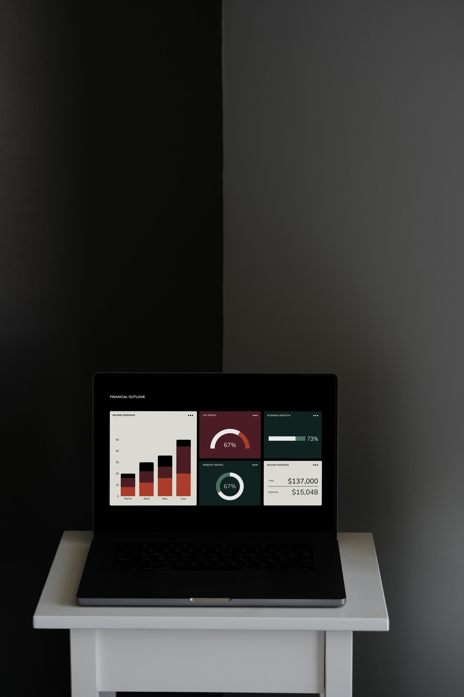
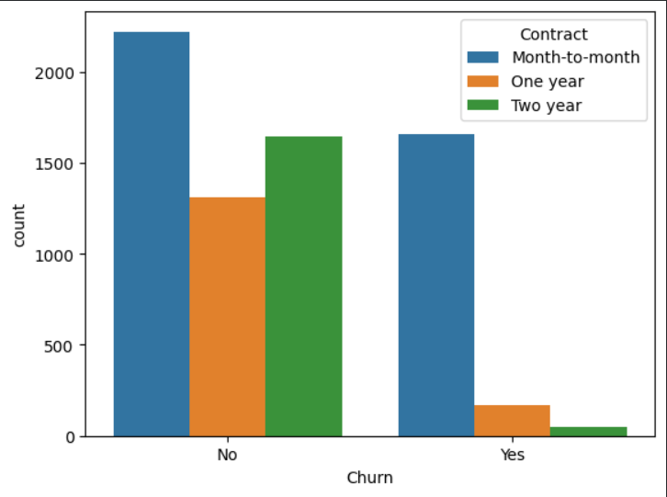
CONTRACT TYPE ANALYSIS
Contract
Month-to-month 3875
Two year 1695
One year 1473
CHURN RATE :
MONTHLY - High Risk
ONE YEAR - Medium Risk
TWO YEAR - Low Risk
Strategic Action
Incentive migration from Month-to-Month plans.

Slide 5

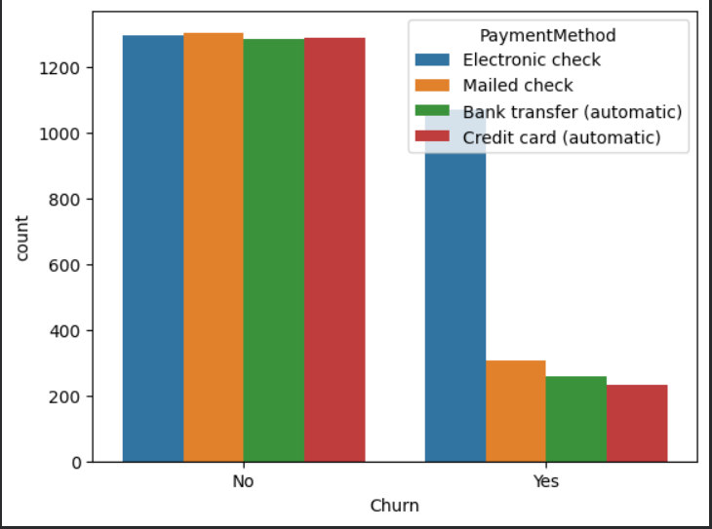
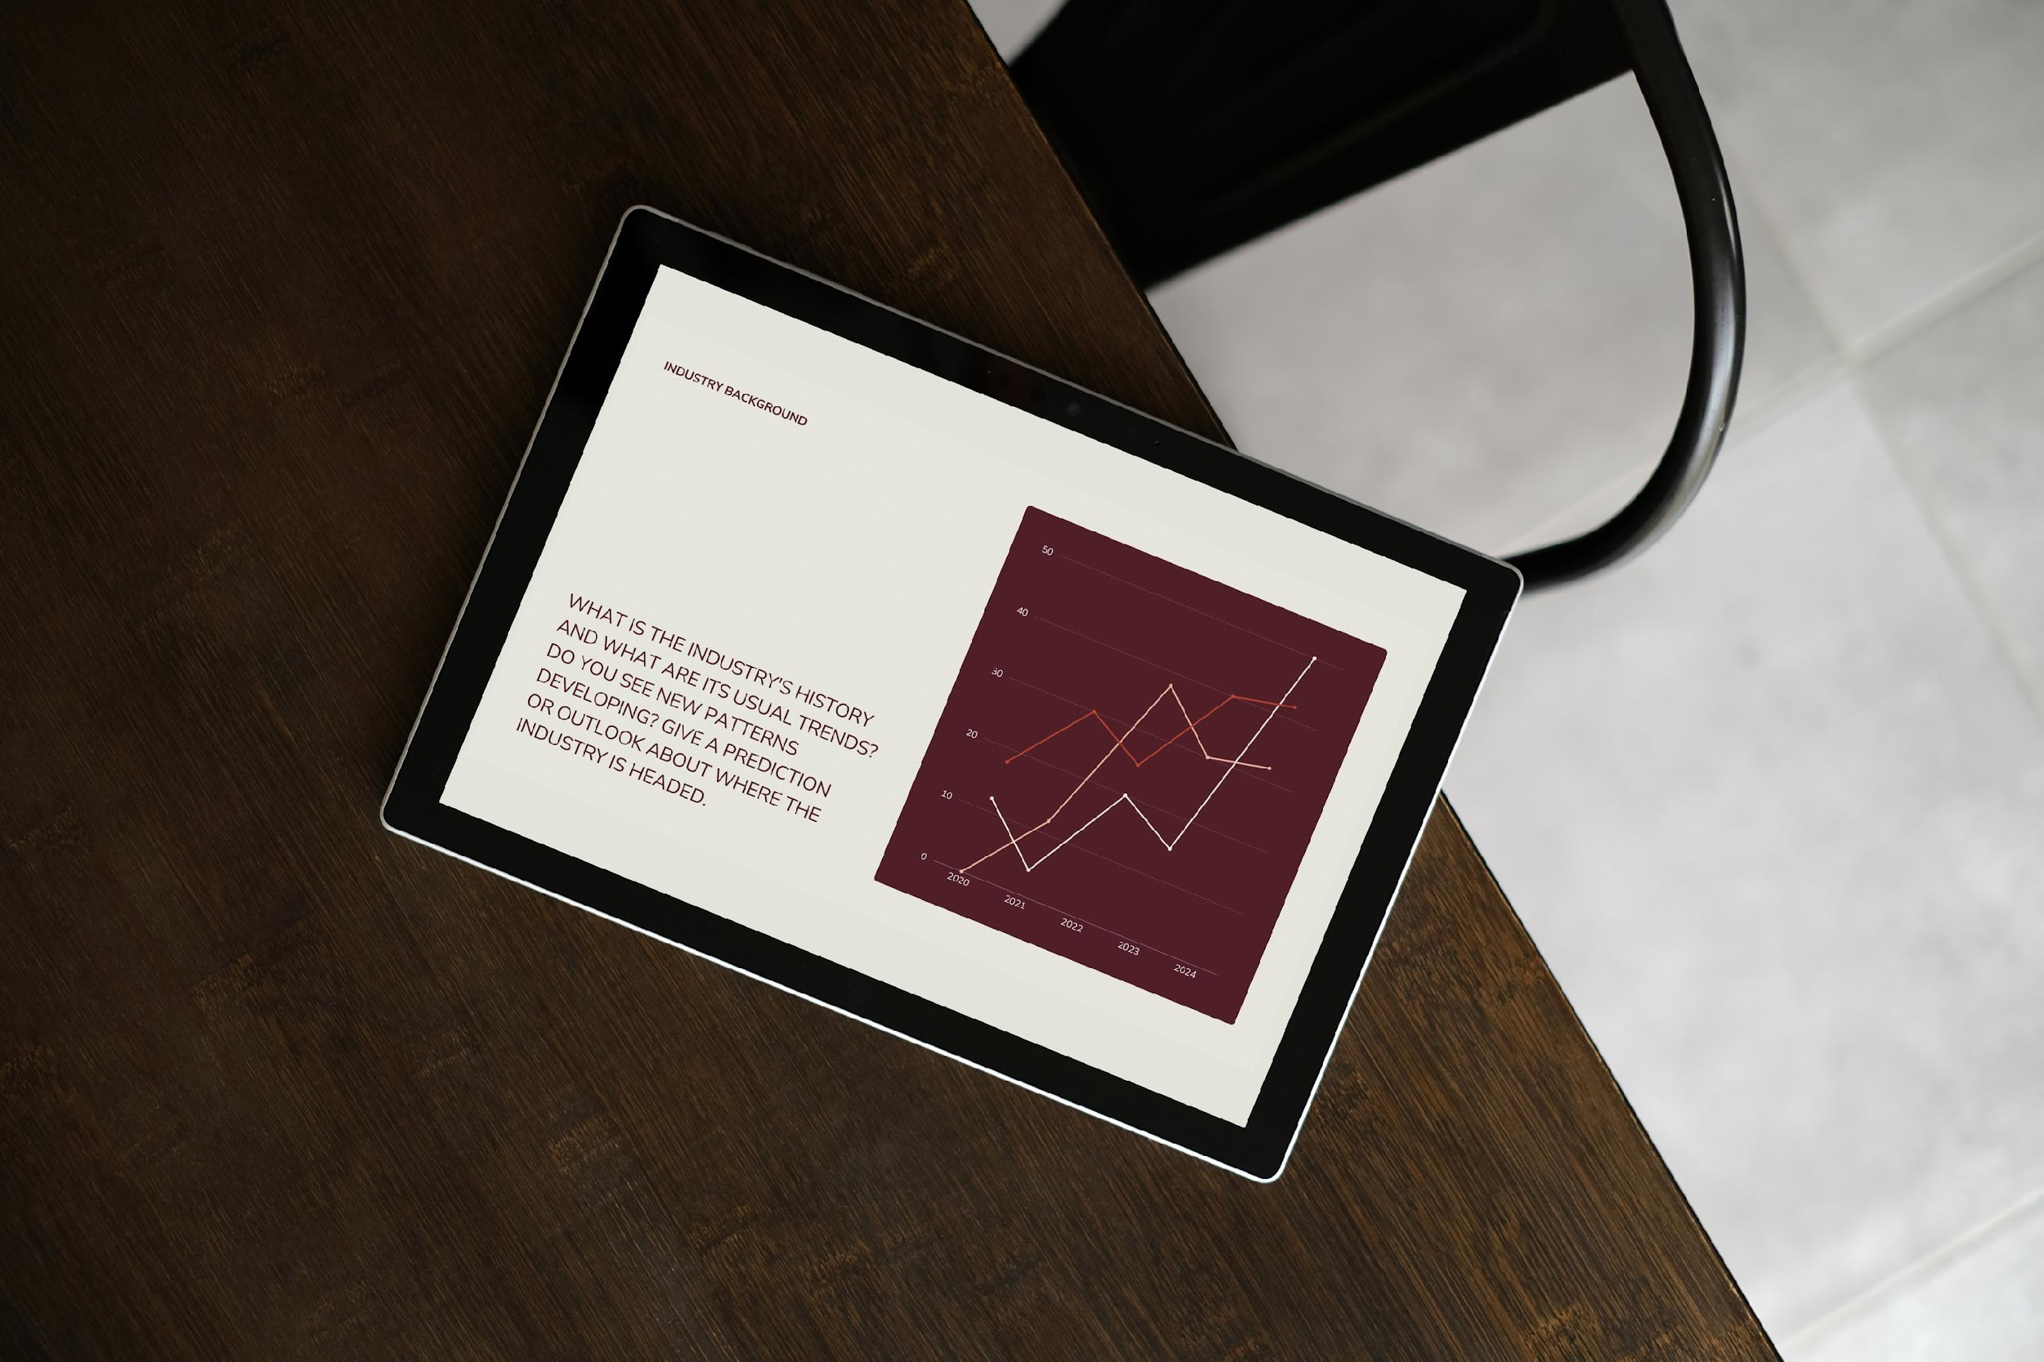
PAYMENT METHOD ANALYSIS
HIGH RISK CHANNEL
Electronic Check users represent the highest churn risk group. Nearly half of these customers leave, significantly higher than automatic payment methods.
Electronic Check : High Risk
Mailed Check : Medium
Credit Card (Auto) : Low Risk
Strategic Action
Migrate Electronic Check users to Autopay.

Slide 6
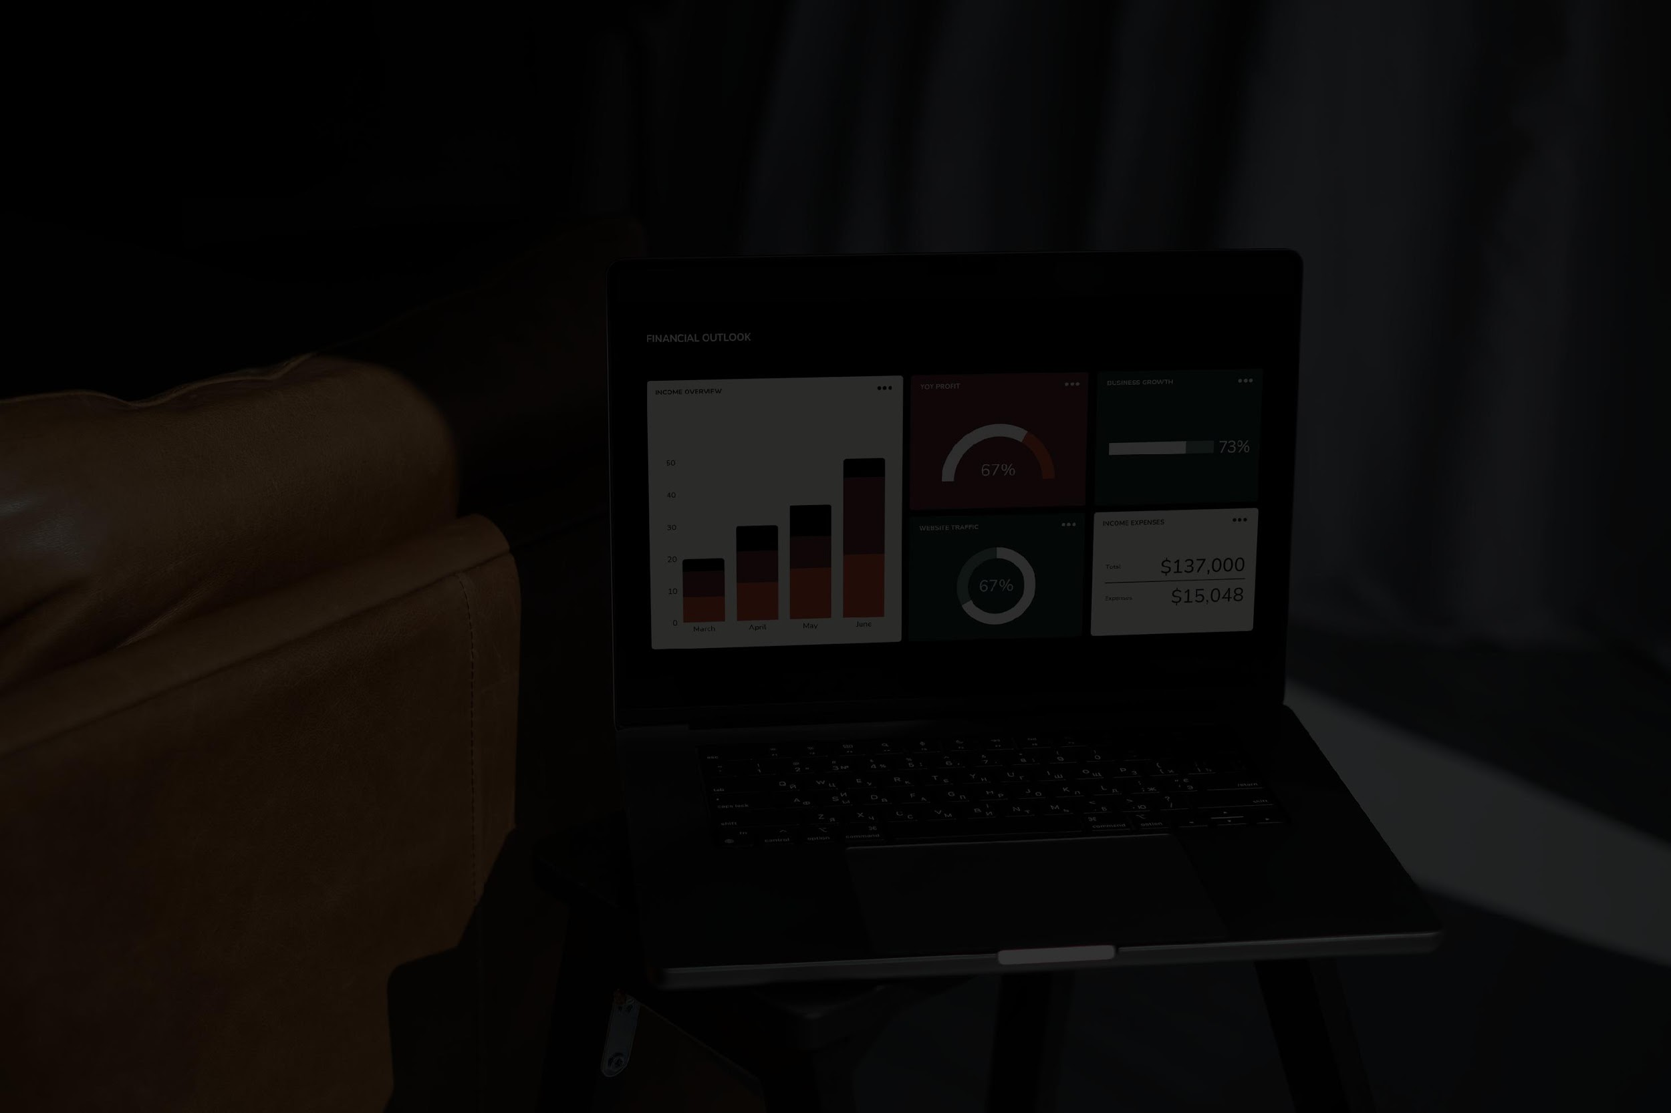
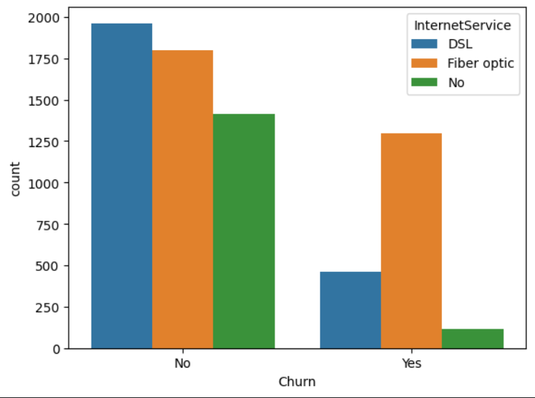
INTERNET TYPE SERVICE IMPACT
Fiber Optic customers show significantly higher churn rates despite being a premium service. This indicates potential price-value mismatch or technical reliability issues.
Fiber Optic : High Risk
DSL : Moderate
No Internet : Low Risk
INTERNET SERVICE
Strategic Action
Investigate fiber quality & support experience.

Slide 7

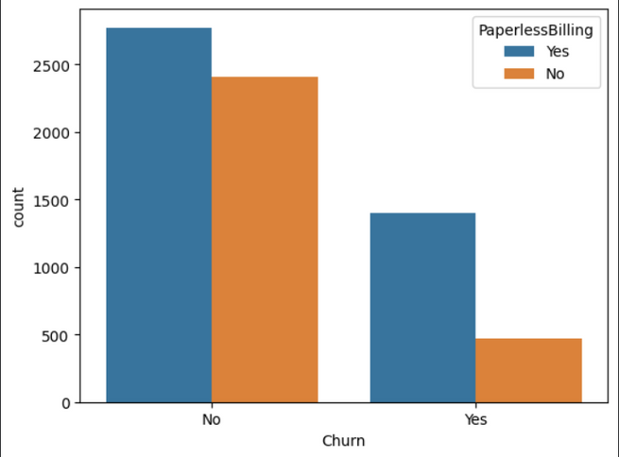
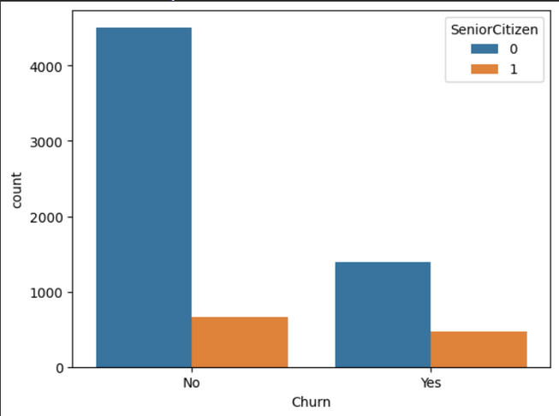
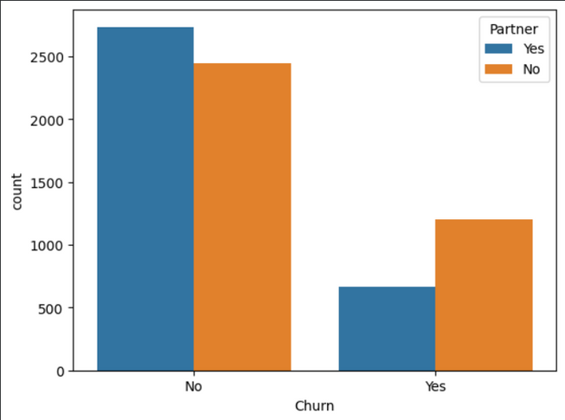
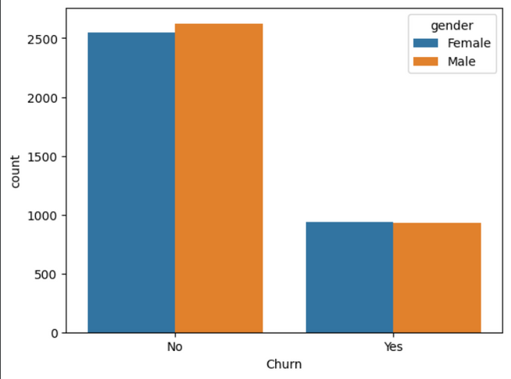
DEMOGRAPHICS & BILLING INSIGHTS
Strategic Implication
  Solo customers (no partner/dependents) and Senior Citizens represent the highest demographic risk segments.
  Family ties create natural retention barriers.
GENDER NEUTRALITY
Minimal impact on churn behavior Not a key differentiator.

Slide 8
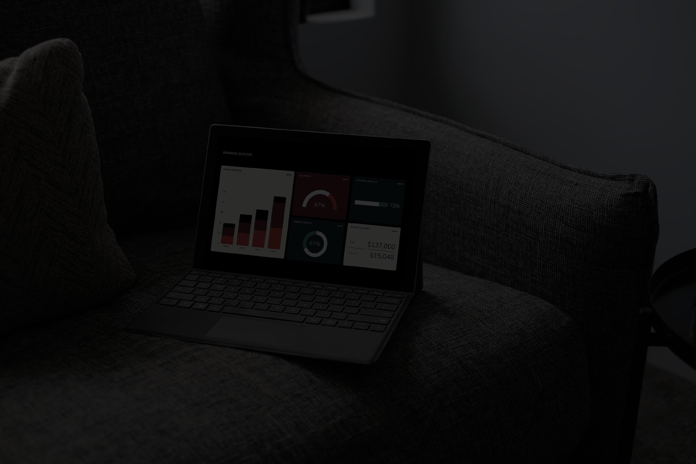
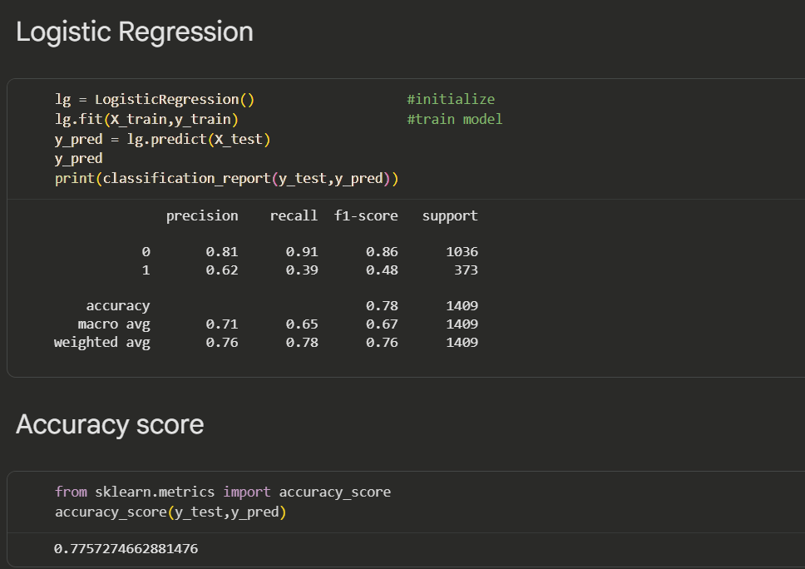
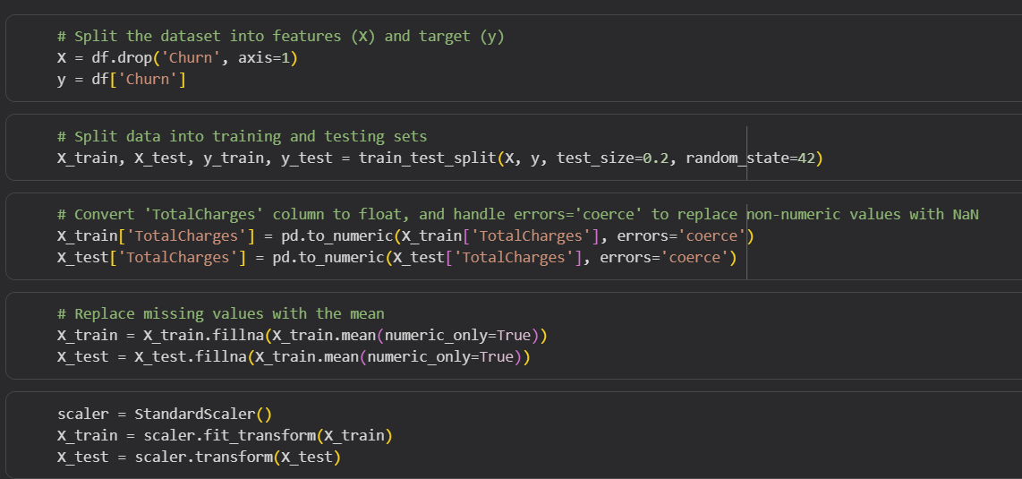
CHURN PREDICTION MODEL
  Model Used: Logistic Regression
  Inputs: Tenure, Monthly Charges, Services, Contract, etc.
  Output: Probability of churn (0 to 1)
  Goal: Identify high-risk customers early
click to see the source code

Slide 9
KEY CHURN DRIVERS
  MONTH-TO-MONTH CONTRACTS → HIGHEST CHURN RISK
  High Monthly Charges → Increased churn probability
  Low Tenure → New customers at higher risk
  Fiber Optic Internet Users → More likely to churn

Slide 10
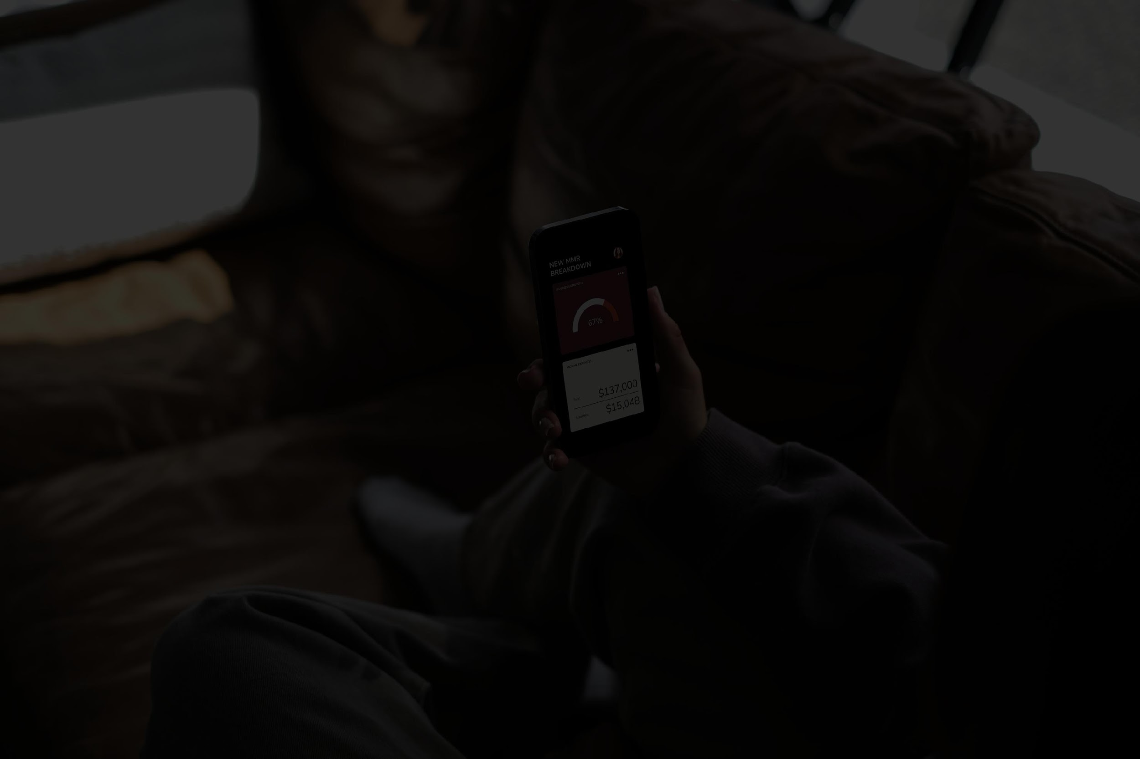

DRIVERS THAT REDUCE
CHURN
  Auto-Pay Billing Methods
  Long-term Contracts (1-Year, 2-Year)
  Stable Internet + Phone Service Combination

Slide 11
RETENTION STRATEGY RECOMMENDATIONS
RECOMMENDATIONS:
  Convert Month-to-Month users to annual plans using discounts
  Provide targeted offers for high-bill customers
  Improve support quality for users with frequent complaints
  Promote auto-pay & paperless billing enrollment

Slide 12
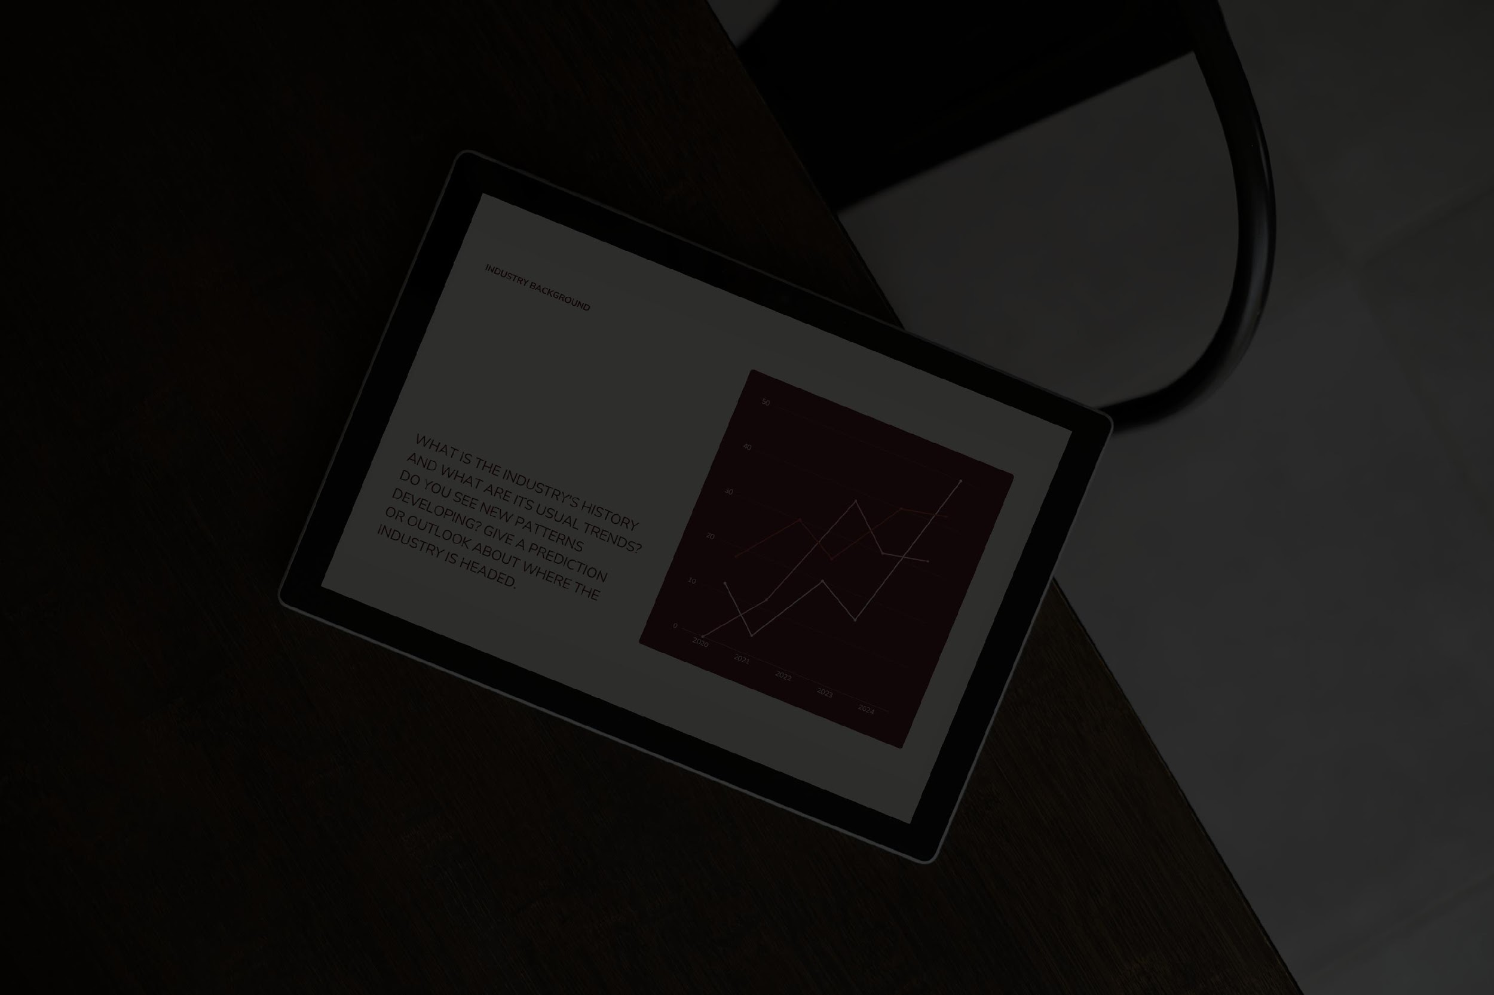
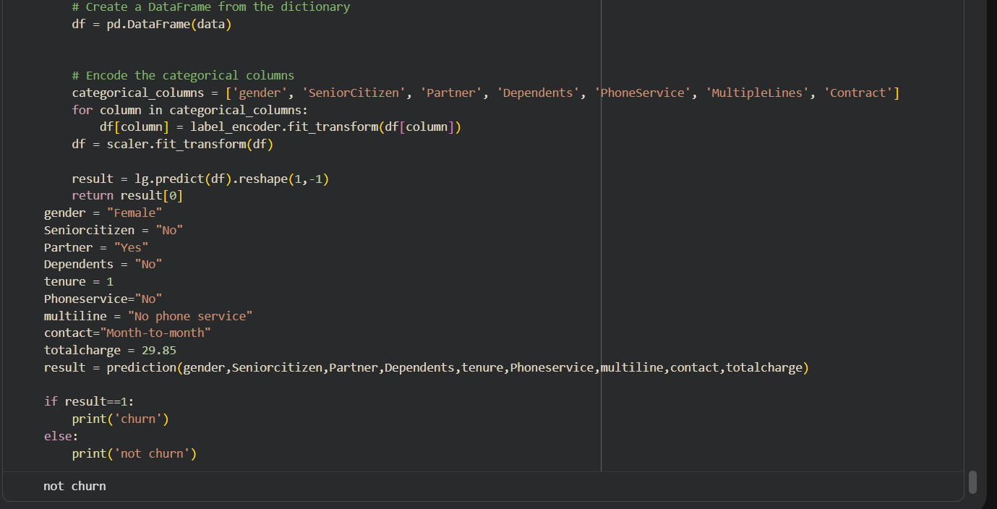

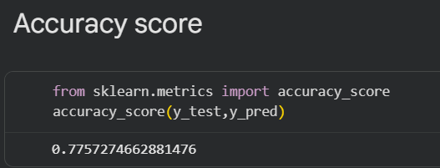
CONCLUSIONS
  Logistic Regression model successfully predicts churn
  Key churn drivers identified clearly
  Practical retention strategies recommended

Slide 13
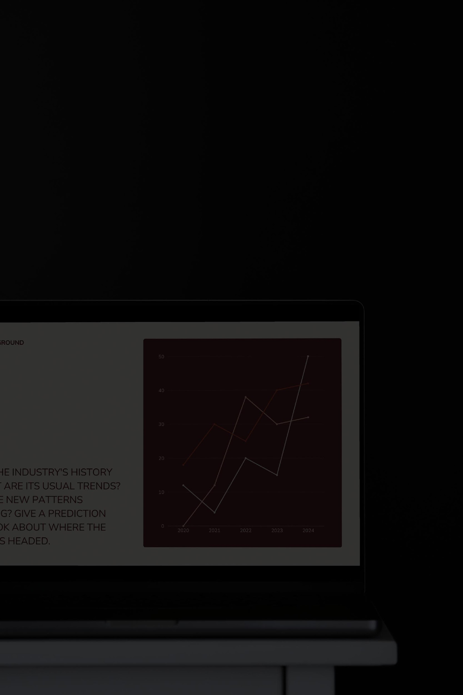
WANT TO SAY
THANK YOU
FOR YOUR ATTENTION

